Slide 1

COMMUNICATING RISKS TO SUPPORT SUSTAINABILITY DISCUSSIONS
Challenges in a post-truth era
Lianne Lefsrud, PhD, PEng
Assistant Professor, Engineering Safety and Risk Management
Faculty of Engineering, University of Alberta
Notes:
Good evening everyone! It’s my pleasure to engage with and continue these energy discussions, especially those regarding:
Social license to operate / govern
Lack of trust and legitimacy with industry and government
This evening, I’ll be presenting research from multiple projects including work for the Alberta Chamber of Resources and research on the emotionality of social and traditional media debates.
I’d like to start with a conundrum:

Slide 2
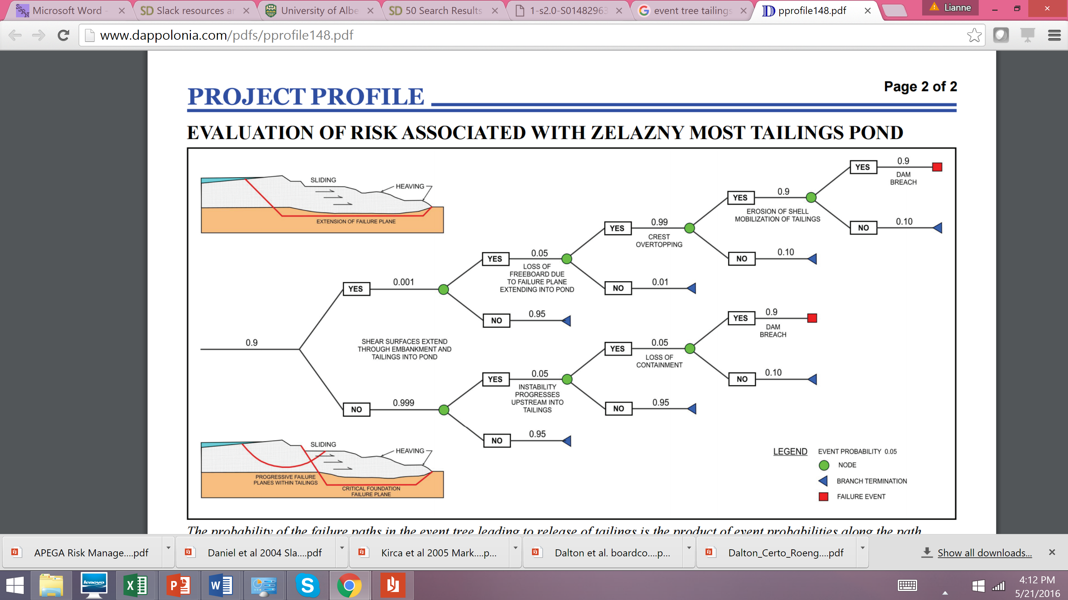
HAZARDS VERSUS RISKS
Hazard is a potential source of harm. What could go wrong?
Risk is a combination of the likelihood of an event and its consequences, usually when there is at least a possibility of negative consequences.
Notes:
Risk is a function of consequences and probability
Any activity – task, procedure, job, operation, etc. – has risk; it has the potential for something to “go wrong”.
“How bad it can be” is expressed as consequences.
“How likely it can happen” is expressed as the probability
Consequences are understood to be the severity of a hazard when it becomes uncontrolled
Probability is understood as the likelihood of that hazard becoming uncontrolled

Slide 3
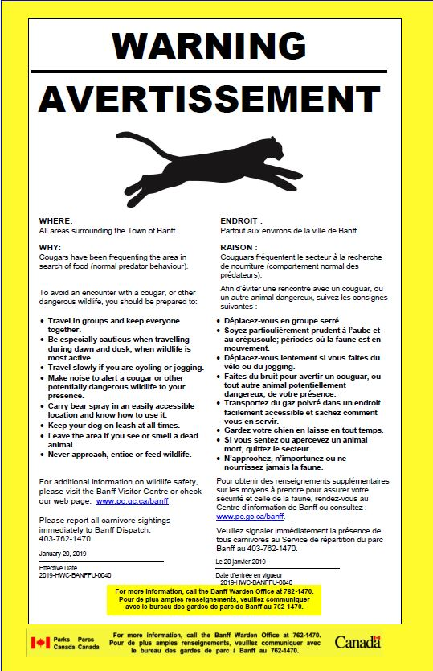
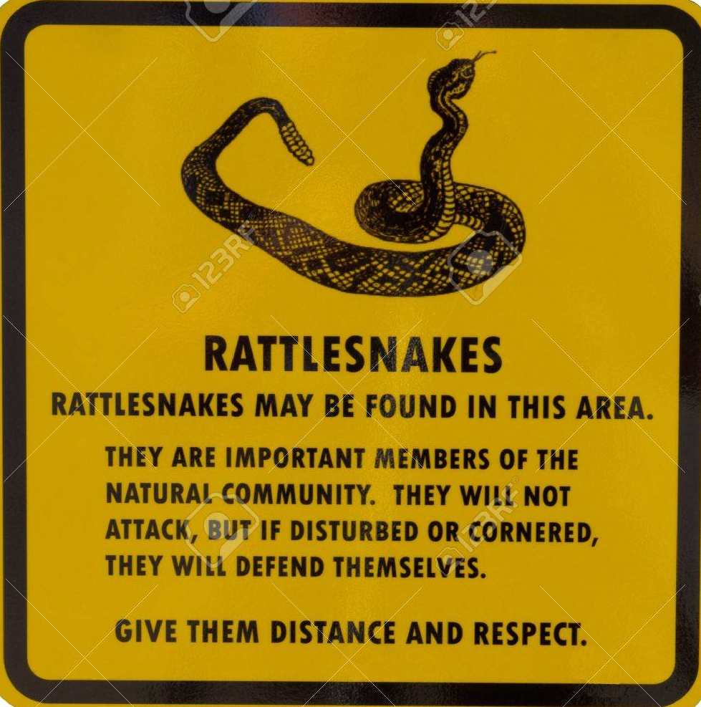
RISK COMMUNICATION
  Risk communication is the “exchange of real-time information, advice and opinions between experts and people facing threats to their health, economic or social well-being.”
*World Health Organization (2019). Risk Communication. Available at: https://www.who.int/risk-communication/background/en/
Notes:
Now, what is risk communication? Again, there are many different definitions of what risk communications is. We are using the definition from health Canada. Which focuses on the exchange of information and the skillful interaction with stakeholders supported by appropriate information.

Slide 4


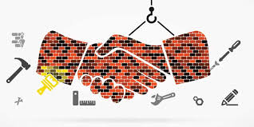

RISK COMMUNICATION
  The purpose of risk communication is
  Enlightenment: making people able to understand risks and become ‘risk literate’
  Behavioural changes: making people aware of potential risks and help them to take protective actions
  Trust building: assisting risk management agencies to generate and sustain trust
  Conflict resolution: assisting risk managers to involve major stakeholders and affected parties to take part in the risk management process
Covello, V. T., Von Winterfeldt, D., & Slovic, P. (1988). Risk communication. In Carcinogen Risk Assessment (pp. 193-207). Springer, Boston, MA.
Renn., O. (2019). Risk Governance Framework. https://irgc.epfl.ch/risk-governance/page-139715-en-html/
Notes:
Now, what is risk communication? Again, there are many different definitions of what risk communications is. We are using the definition from health Canada. Which focuses on the exchange of information and the skillful interaction with stakeholders supported by appropriate information.

Slide 5
UNDERSTANDING AND MANAGING RISKS
Sustainable design and development is measured by balanced management of
  Economic risks
  Safety risks
  Environmental risks
There are many complex interactions between an operating production process and the environment.
We need “permission” from society to operate (often delegated to the government)
  This permission can be revoked or modified
  “License to Operate” from Federal or Municipal Regulators are just one example
Notes:
Changed title and first point
Added or modified

Slide 6
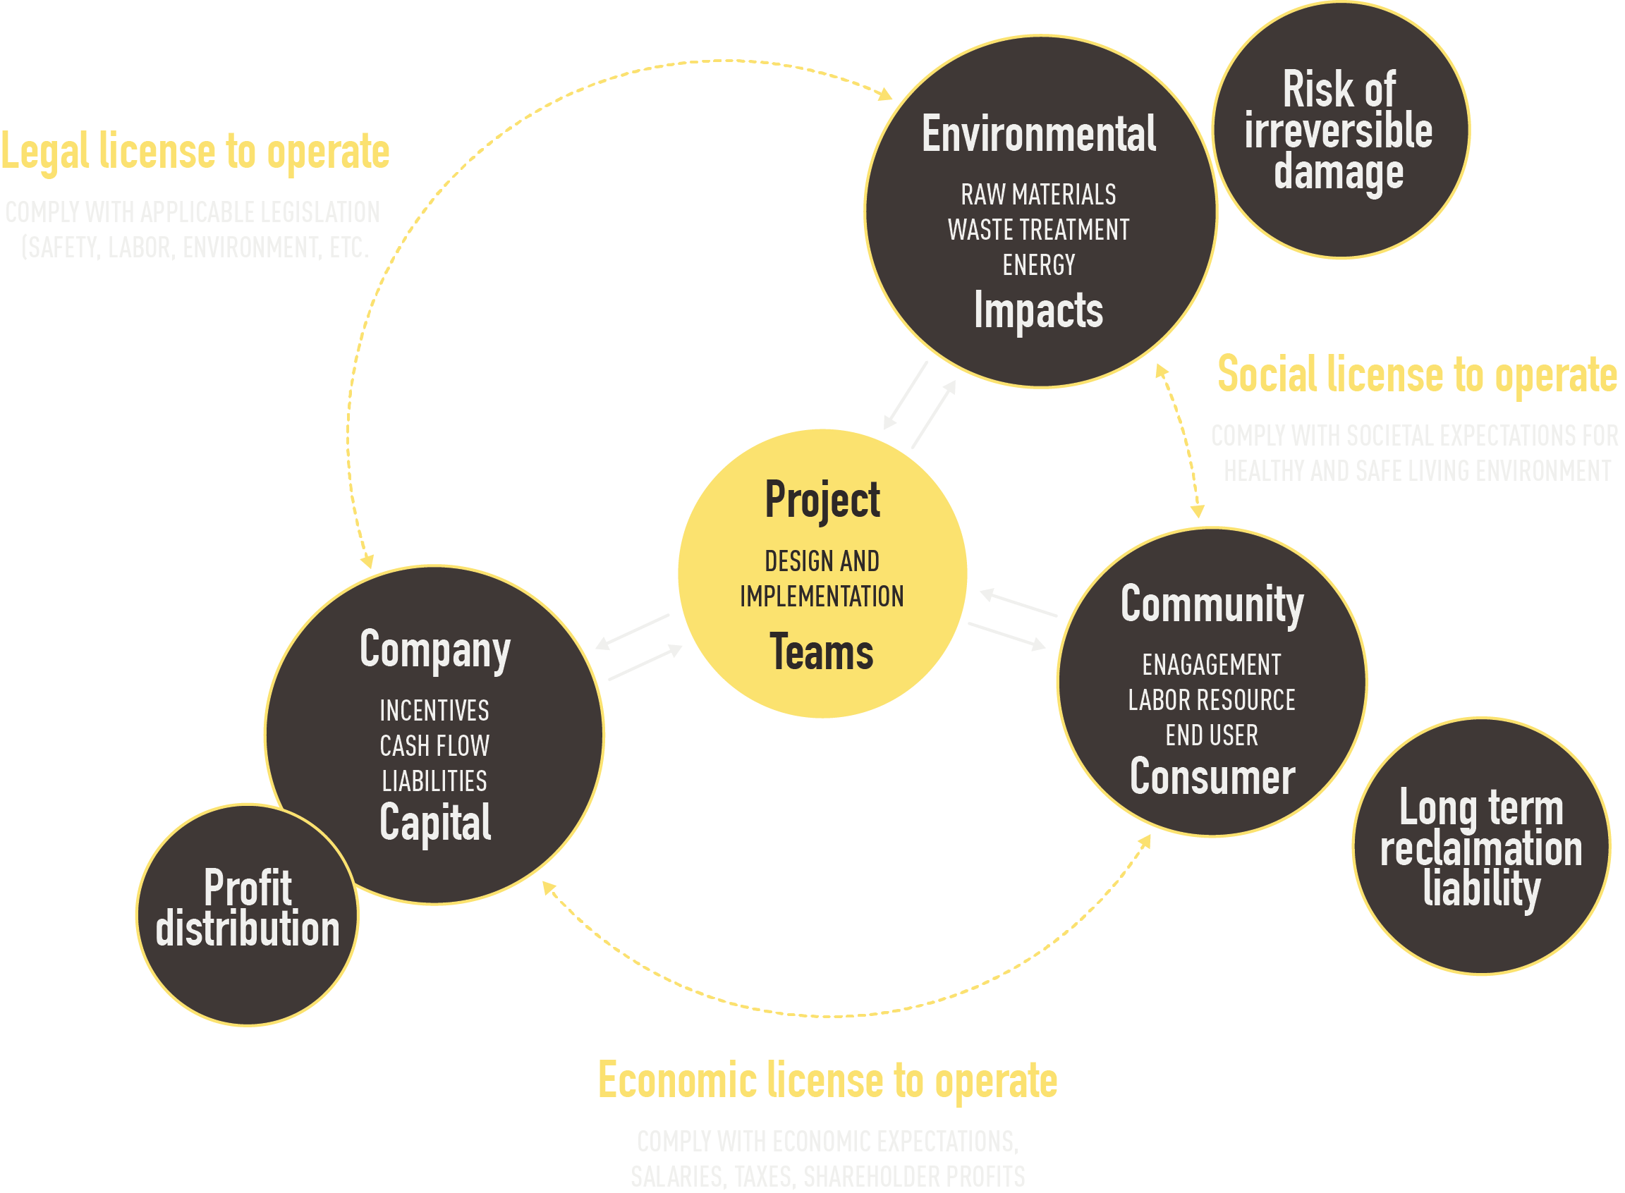
WHY COMMUNICATE RISKS?
Broader social values determine project acceptability
Project acceptability depends on economic, legal AND social license to operate

Slide 7
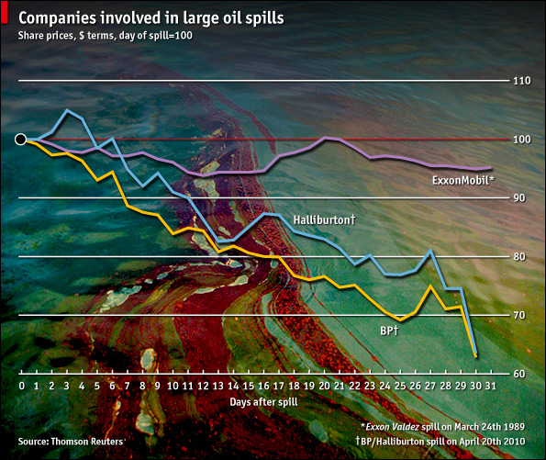
MISMANAGED SAFETY AND ENVIRONMENTAL RISKS BECOME SOCIAL AND FINANCIAL RISKS!

Slide 8
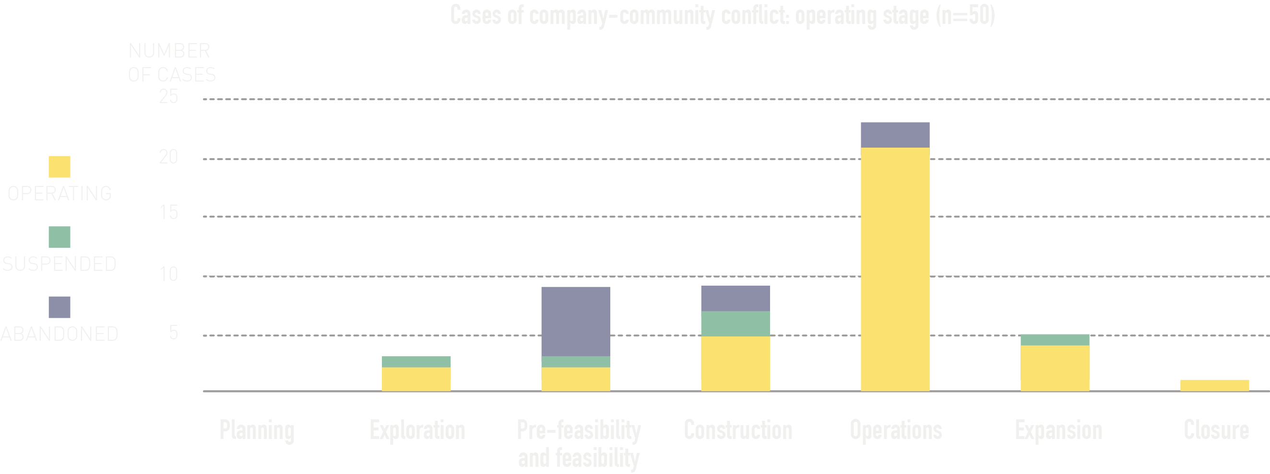
MISMANAGED SAFETY AND ENVIRONMENTAL RISKS BECOME SOCIAL AND FINANCIAL RISKS!
Non-technical risks are 50% of risk factors in extractive industries
One oil major estimates US$6.5 billion value erosion over a two-year period from stakeholder-related risks
Community conflicts can lead to project suspensions and abandonments
Ruggie, J. (2011). Report of the Special Representative of the Secretary-General on the issue of human rights and transnational corporations and other business enterprises. Netherlands Quarterly on Human Rights, 29, 224.
Davis, R., & Franks, D. M. (2011, October). The costs of conflict with local communities in the extractive industry. In Proceedings of the First International Seminar on
Social Responsibility in Mining, Santiago, Chile (Vol. 30).
Notes:
I may have a few other slides that we can use

Slide 9

PRODUCTS / PROJECTS WITH LEGAL LICENSE
CAN BECOME SOCIALLY UNACCEPTABLE…
Notes:
Silent spring was published in 1962.

Slide 10
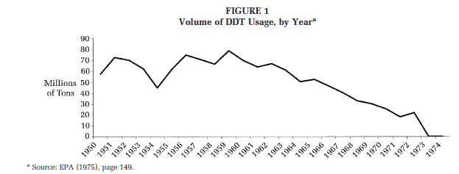
Decline of DDT Usage
Maguire, S., & Hardy, C. (2009). Discourse and deinstitutionalization: The decline of DDT. Academy of Management Journal, 52(1), 148-178.
Notes:
Changed ‘legally produced’ with ‘legal license’, to be consistent with previous terminology

Slide 11
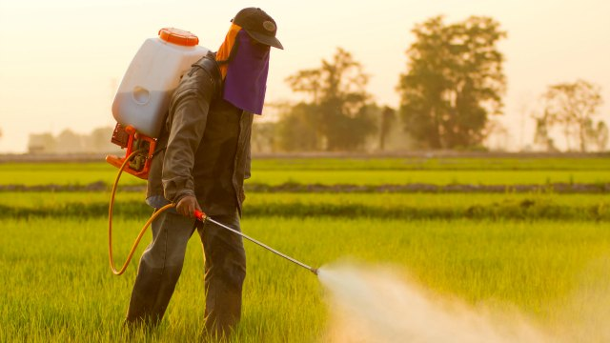
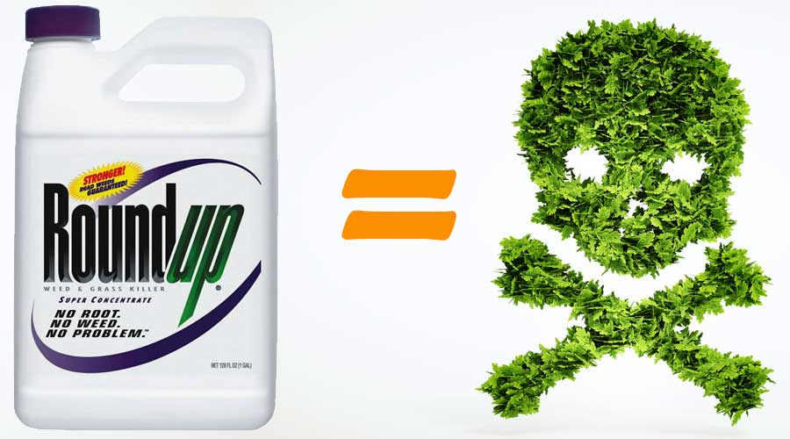
LEGAL PROCEEDINGS CAN CHALLENGE SCIENTIFIC RISK ANALYSIS
Roundup has been used since 1974
August 2018, Monsanto ordered to pay $289 million in world's first Roundup cancer trial, which was reduced to $80 million on appeal
“Today’s decision does not change the fact that more than 800 scientific studies and reviews...support the fact that glyphosate does not cause cancer, and did not cause Mr. Johnson’s cancer,” the company said.

Slide 12
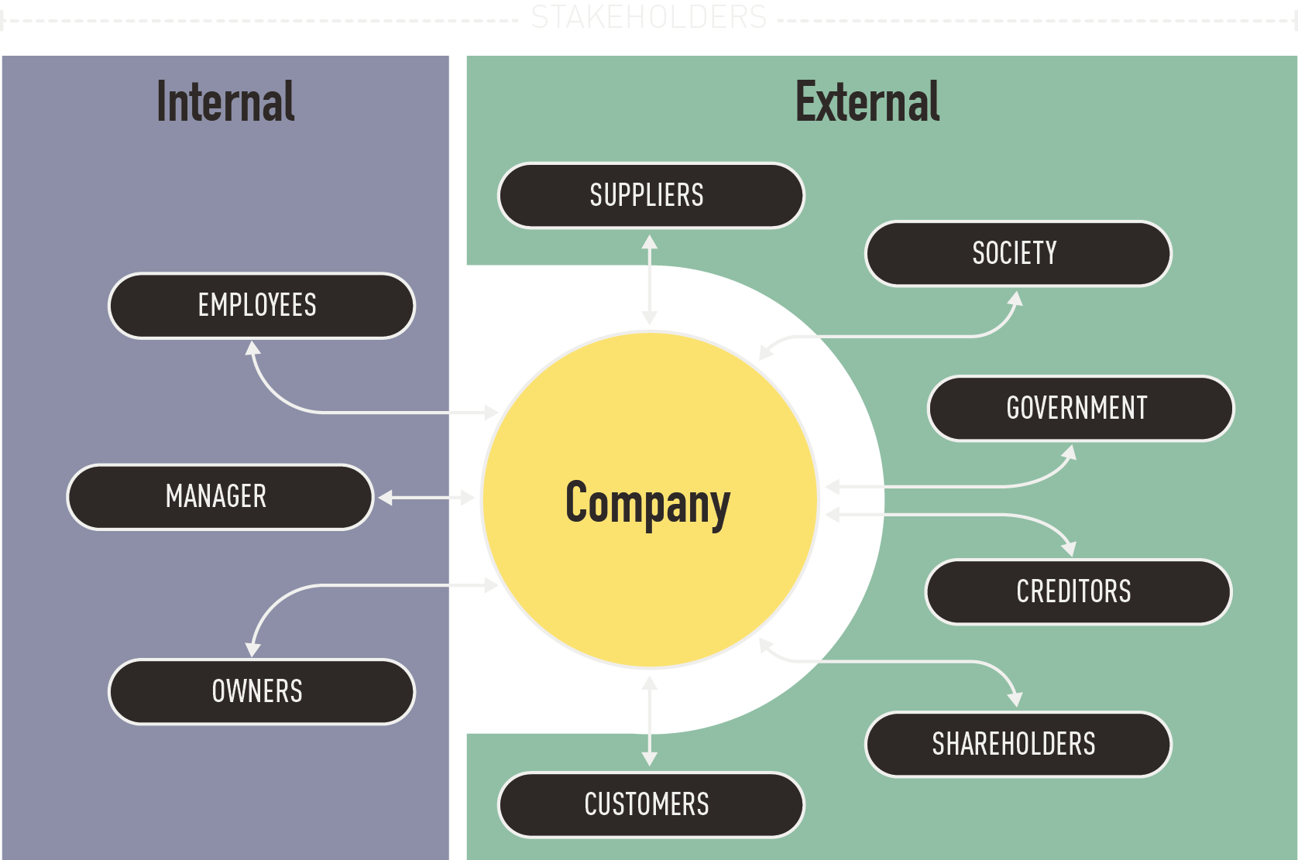
WHO TO COMMUNICATE WITH?
Stakeholder* - any person or organization that can effect or be affected by a decision or activity.
Including those who believe that a decision or an activity can affect them
May be internal or external
*According to ISO 31000

Slide 13
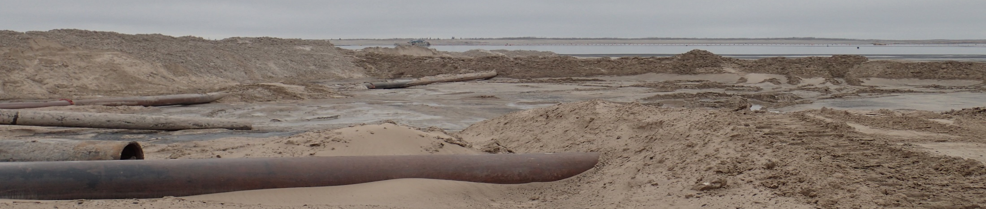
WHO TO COMMUNICATE WITH?
EXTERNAL AND INTERNAL RISK COMMUNICATION
  Typically organizations consider risk communication to their external stakeholders, such as members of the public
  Growing need for organizations to communicate risks to internal stakeholders such as employees and contractors
  External communication tools can be applied to internal risk communication
TAILINGS DISCHARGE AREA
Notes:
Risk communication is typically from an organization to the public, discussing things like drinking and driving, tsunami preparation or smoking. There is however a growing need for the communication of risks from organizations to workers and contractors especially in areas like the oil sands tailings where conditions are dynamic and harsh.
External risk communication is a very well researched and developed field. We are proposing that some of the tools can be used from external risk communication to communicate risks internally across organizations and to contractors.

Slide 14
INTERNAL COMMUNICATION:
UNCOVERING HIDDEN HAZARDS

Slide 15
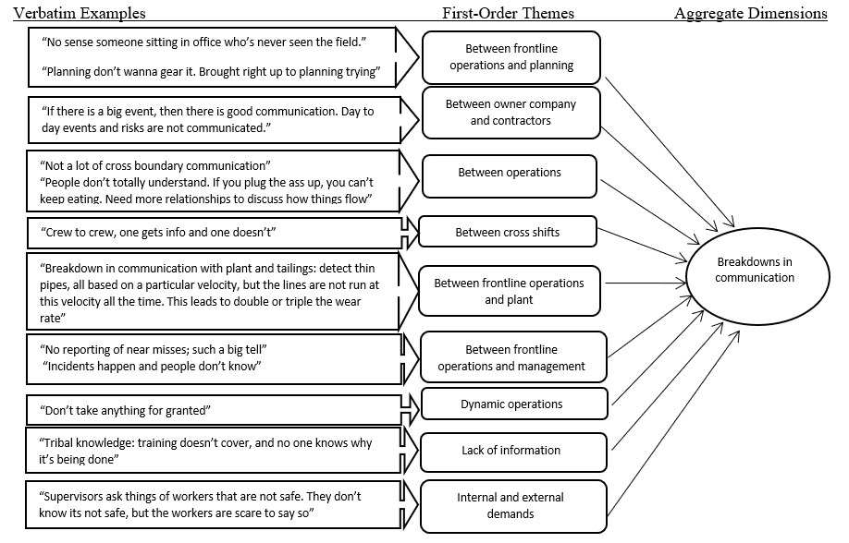
INTERNAL COMMUNICATION:
BREAKDOWNS IN RISK COMMUNICATION
Notes:
Here are verbatim examples from the interview data that represent breakdowns in communication. They were identified between every working group and even from organizational factors like lack of info, external and internal demands and the dynamic operations. 15% of interview participants did not mention a ground hazard in their interview, 23% of the incidents in the database related to ground hazards, Under reporting of ground hazards in incident database

Slide 16
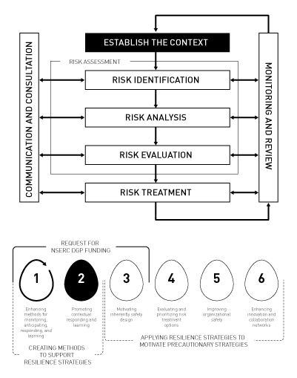
WHEN TO COMMUNICATE?
At each step of risk management process.
ISO, (2009). 31000 Risk management–Principles and guidelines. International Organization for Standardization, Geneva, Switzerland.

Slide 17
CHALLENGES IN RISK ANALYSIS AND COMMUNICATION
Complexity in assessing causal and temporal relationships
Uncertainty
  Variation among individual targets
  Measurement and inferential errors
  Genuine stochastic relationships
  System boundaries and ignorance
Ambiguity in interpreting results
Renn., O. (2019). Risk Governance Framework. https://irgc.epfl.ch/risk-governance/page-139715-en-html/
Notes:
Great slide

Slide 18
COMPLEXITY IN ASSESSING CAUSAL AND TEMPORAL RELATIONSHIPS
Characteristics
  Transboundary effects (ubiquity)
  Highly interconnected (natural, technical, social)
  Stochastic (second order uncertainty)
  Non-linearity with tipping points
Problems
  Limits of quantification
  Fragmented responsibilities, lack of coordination
  Contra-intuitive implications
  Inadequacy of trial and error learning modes
Renn., O. (2019). Risk Governance Framework. https://irgc.epfl.ch/risk-governance/page-139715-en-html/
Notes:
Great slide

Slide 19
VARIOUS SOURCES OF UNCERTAINTY
Saltelli, A., Aleksankina, K., Becker, W., Fennell, P., Ferretti, F., Holst, N., Li, S. and Wu, Q., (2019). Why so many published sensitivity analyses are false: A systematic review of sensitivity analysis practices. Environmental Modelling & Software.
Notes:
Great slide

Slide 20
AMBIGUITY IN CONSTRUCTING AND INTERPRETING RESULTS
Lefsrud, L.M., Fox, K.A., Cooper, D.J. & Taminau, Y. (2019). Veils of Ambiguity: Professionals’ Categorization of Oil and Gas Reserves . Under review.
Notes:
Great slide

Slide 21
ADDITIONAL RISK PERCEPTION COMPLICATIONS
POST-TRUTH: Simple causality models based on plausibility and confusion about plurality of truth claims
POST-TRUST: Reliance on trust where immediate experience is missing
POST-REALITY: Amplification by virtual reality and social media
Renn., O. (2019). Risk Governance Framework. https://irgc.epfl.ch/risk-governance/page-139715-en-html/
Notes:
Great slide

Slide 22
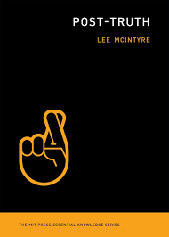
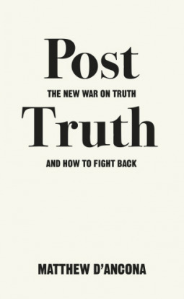
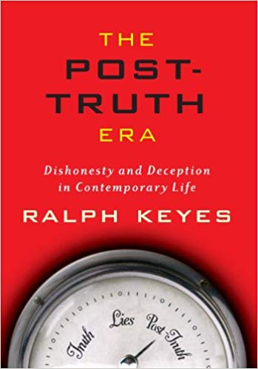


POST-TRUTH AND ALTERNATIVE FACTS
Renn., O. (2019). Risk Governance Framework. https://irgc.epfl.ch/risk-governance/page-139715-en-html/
Notes:
Great slide

Slide 23
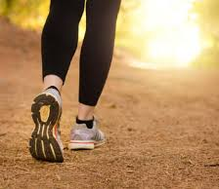

Trust arrives on foot and leaves on horseback…
POST-TRUST
Dutch proverb "Vertrouwen komt te voet en vertrekt te paard."

Slide 24
DISTRUST IN NGOS, GOVERNMENT, BUSINESS AND MEDIA CONTINUES
Edelman Trust Barometer, 2019 Annual Global Study

Slide 25
HUGE GAP IN TRUST BETWEEN INFORMED PUBLIC AND MASS POPULATION,
Edelman Trust Barometer, 2019 Annual Global Study

Slide 26
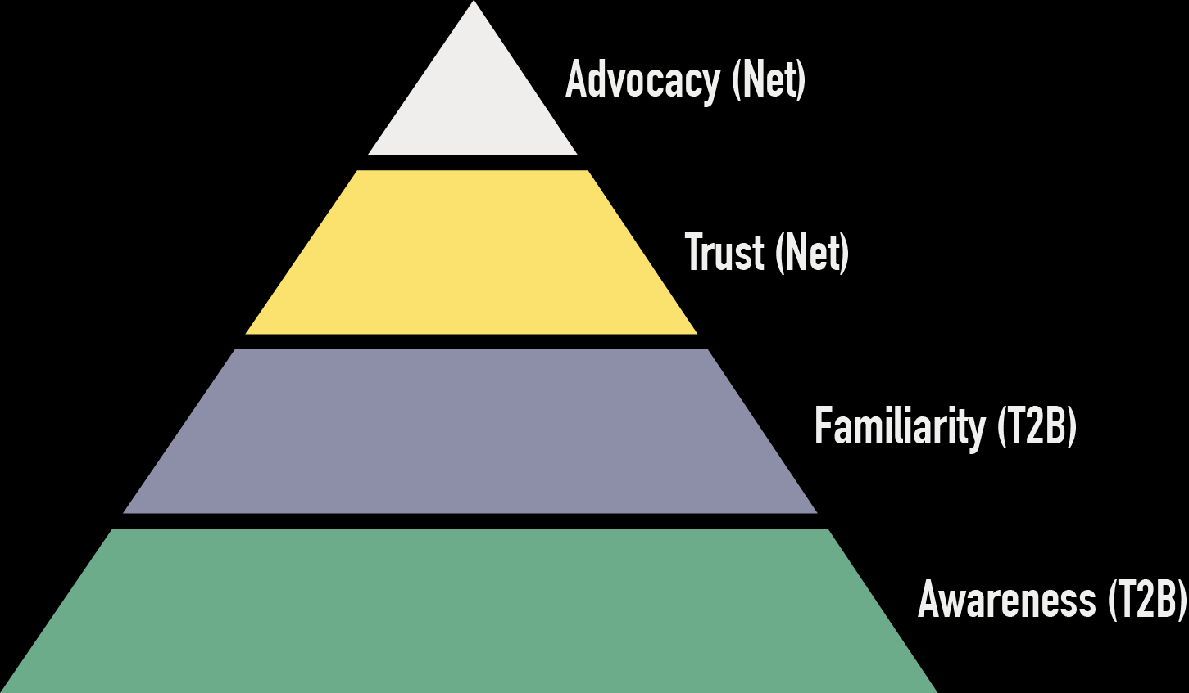
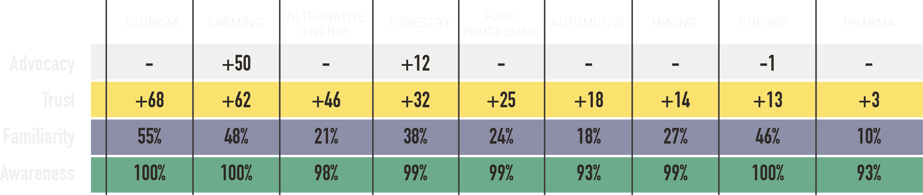
Previously accepted model of how to support is built is no longer applicable for mining and energy
Cleland and Canada West Foundation, November 2014
Notes:
In 2014, the Canada West Foundation surveyed 3000 people in the four Western provinces and Ontario, for their attitudes towards various industries. While Farming and Forestry enjoy a high level of advocacy and trust, Mining and Energy were highlighted as being the lowest. According to the Ipsos Reid corporate reputation model, familiarity is the bedrock of reputation; familiarity breeds trust and advocacy.
As shown by Michael Cleland in November 2014, these survey results for the Energy industry do not follow this model. … Public attitudes have likely shifted even more negatively, especially for mining and energy, even more in the past 18 months.
Reasons to trust Mining: Government regulated 21%; Good for the economy, creates jobs 19%
Reasons to distrust Mining: Bad for the environment, non-sustainable practices 37%; Motivated by financial gains, not socially responsible 26%
Reasons to trust Energy: Good for the economy, creates jobs 20%; Government regulated 19%
Reasons to distrust Energy: Motivated by financial gains, not socially responsible 48%; Bad for the environment, non-sustainable practices 34%

Slide 27
COMPANY VOICES OFTEN TRUSTED TO GIVE INFORMATION
Edelman Trust Barometer, 2019 Annual Global Study

Slide 28
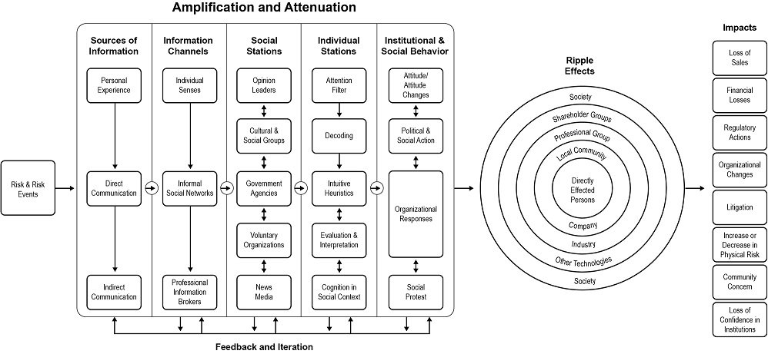
POST REALITY:
Social amplification / attenuation of risk
Renn, O. (2011). The social amplification/attenuation of risk framework: application to climate change. Wiley Interdisciplinary Reviews: Climate Change, 2(2), 154-169.
Notes:
This is the framework that Kasperson developed to help understand why attenuation of risks occurs, in this particular case, a derailment. This related to Sandman’s outrage theory that humans will increase the risk level of hazards that scare them and decrease or attenuate the risk level of things that they are not afraid of.

Slide 29
NEWS IS BEING AMPLIFIED
Edelman Trust Barometer, 2019 Annual Global Study

Slide 30
WHO AMPLIFIES MEDIA INFORMATION?
Edelman Trust Barometer, 2019 Annual Global Study

Slide 31
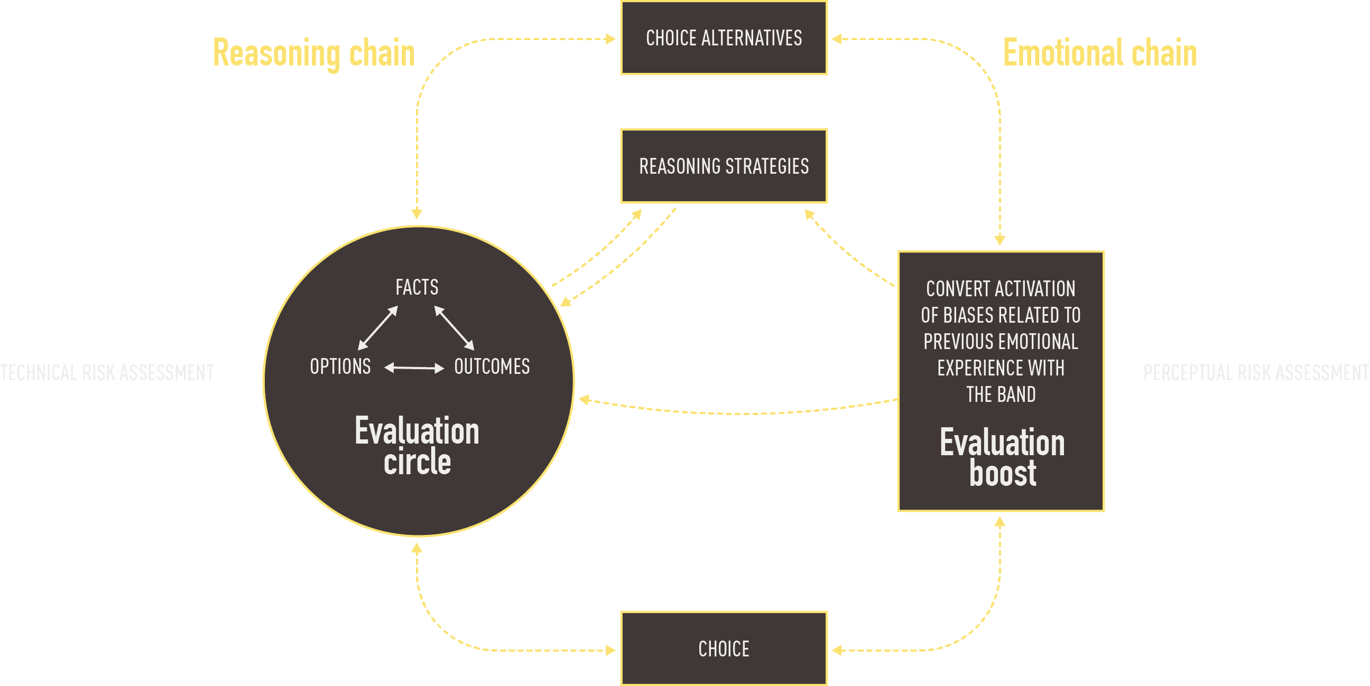
Decision making is rational AND emotional
insights.unimelb.edu.au/vol4/15_harris.html
Notes:
Emotions have been shown to dominate our evaluations, decision-making, and many other individual- and group-level processes.
Thus, relying on exclusively cognitive and rational reasoning will not capture this trust -> social license -> legitimacy conundrum.

Slide 32
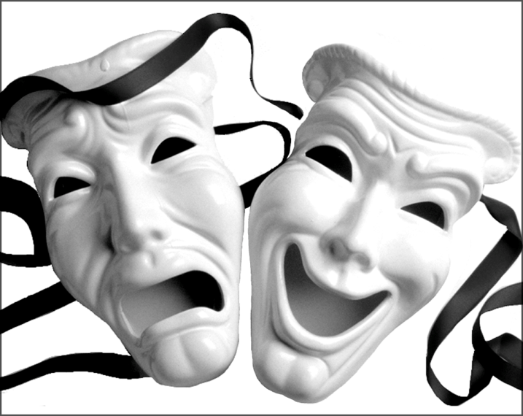
THUS, RATHER THAN IGNORING EMOTION, WE MUST UNDERSTAND AND MEASURE IT!
Computational models are used to estimate human judgments of two
key emotion dimensions:
  Valence: Whether a things is good or bad (pleasure/displeasure)
  Arousal: How good or bad a thing is and its likelihood of motivating action
We built mathematical (regression) models using co-occurrence similarity to a large set of emotion terms to estimate ~78,000 human valence and arousal judgments of individual words
Hollis, G., Westbury, C., & Lefsrud, L. (2017). Extrapolating human judgments from skip-gram vector representations of word meaning. The Quarterly Journal of Experimental Psychology, 70(8), 1603-1619.

Slide 33
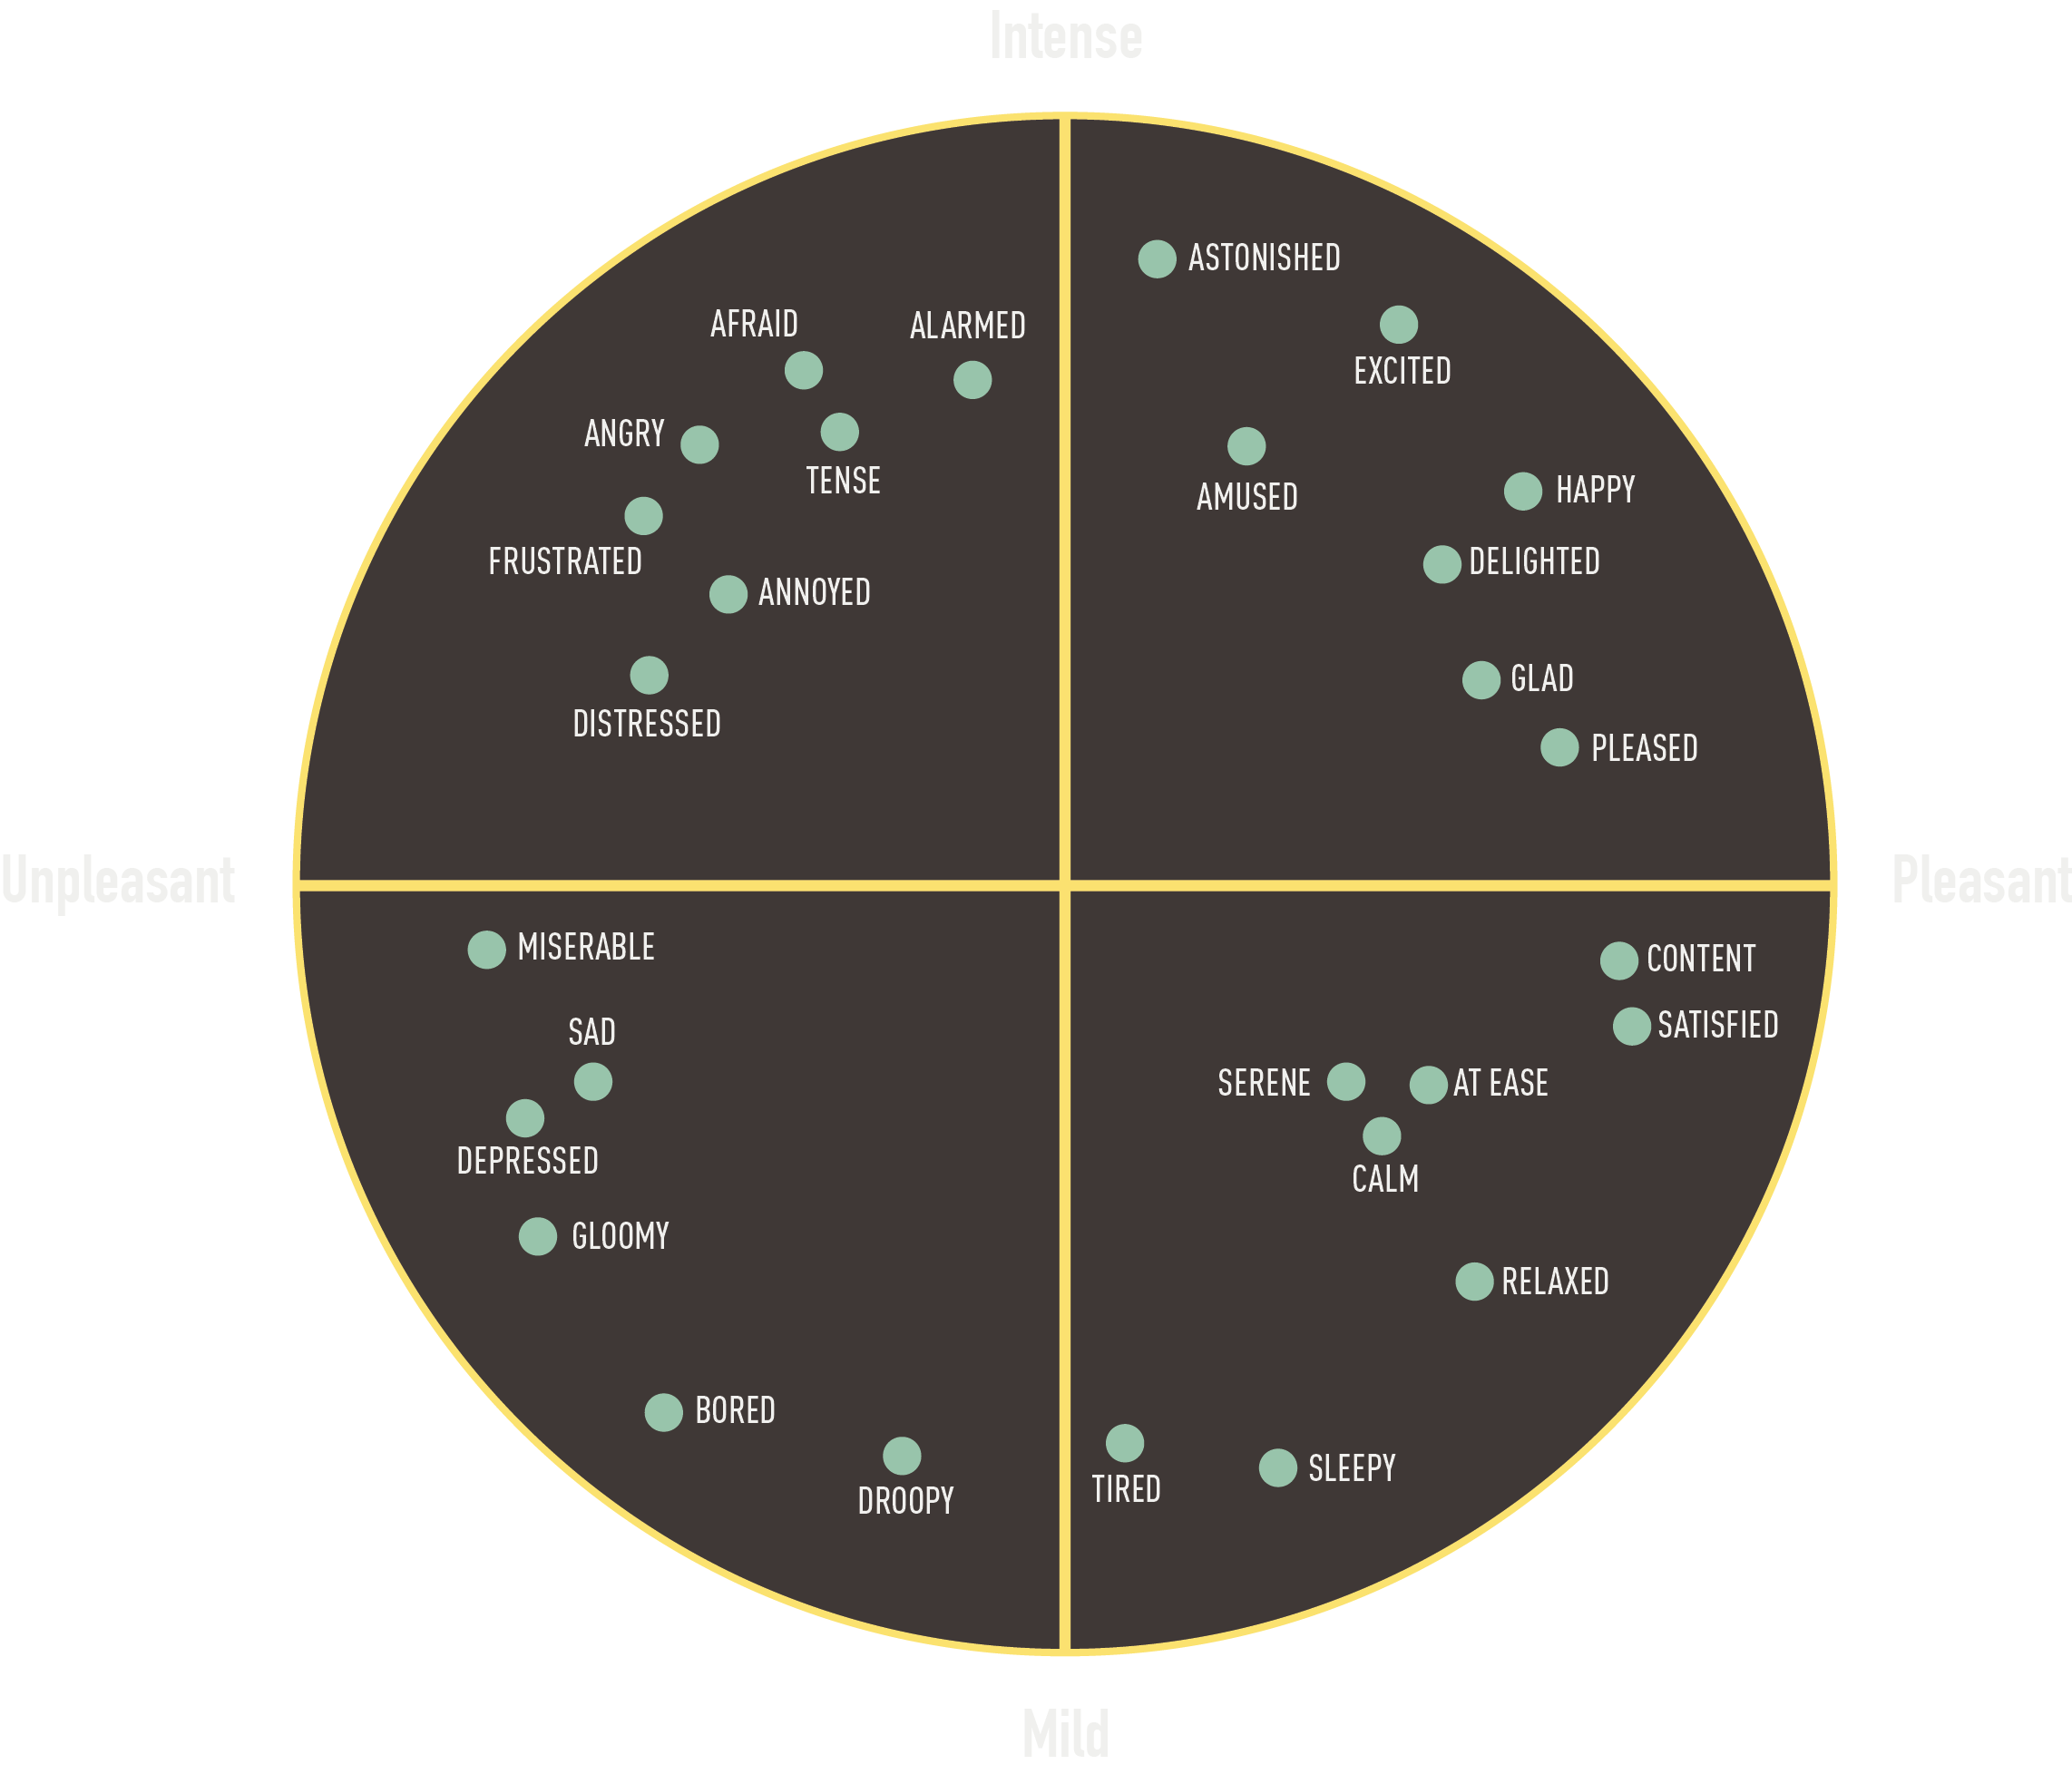



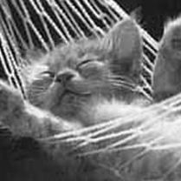

Slide 34
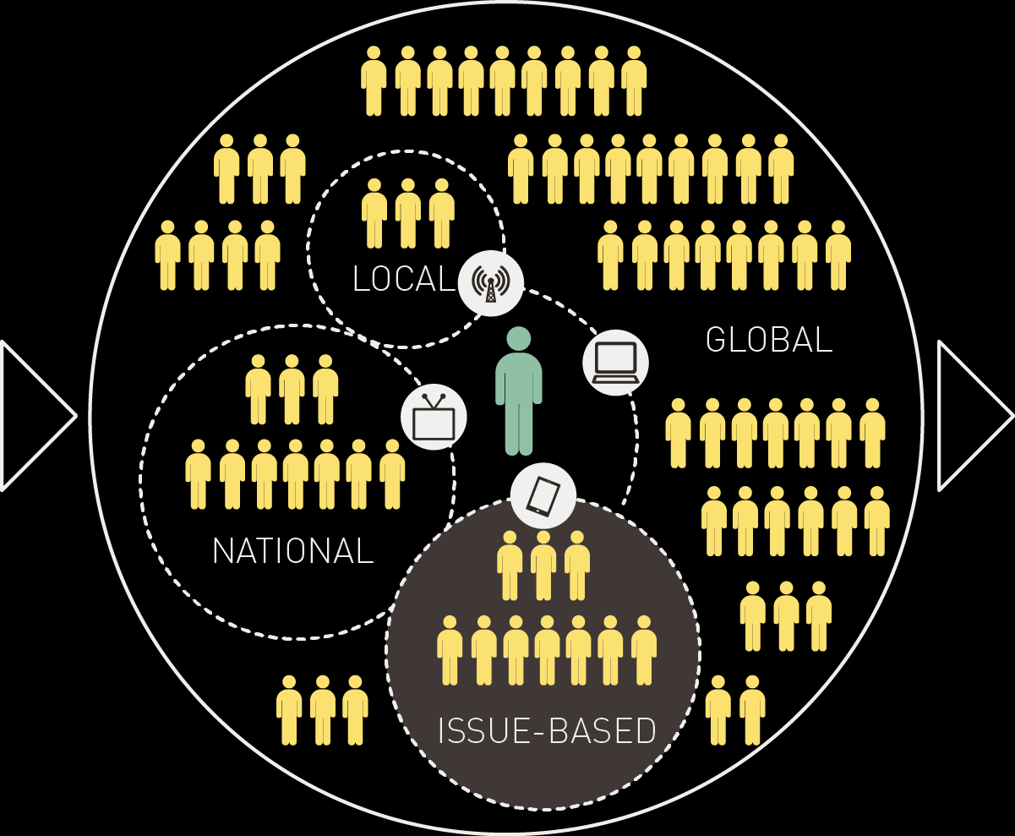

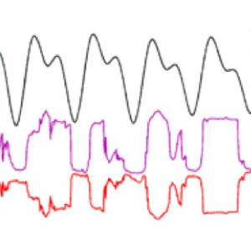
How can we understand development discussions?
Lefsrud et al. (2015) ACR Genuine Dialogue
471,000 article (441.6 million word) corpus of newspapers articles published 1989 – 2015
Oil & Gas: 130,198 (100 / wk)
Mining: 83,061 (64 / wk)
Electricity: 25,168 (20 / wk)
Forestry: 18,844 (15 / wk)
Rail: 11,086 (9 / wk)
Pipelines: 8,085 (6 / wk)
Determining industry key words
and key topics or conversations:
What are people talking about?
Analyze measures of emotionality:
How do they feel about your
industries/issues?
Developing the corpora of texts:
Where are the conversations of interest?
Identifying key negative/positive events as potential ‘game changers’.
What do various audiences pay attention to?
So what? How do these conversations affect your company/industry?
Which outcome variables are of greatest use?
Outcome variables
Share price
Commodity price
Media attention
Analyze how do these conversations relate to each other? Complete time series analysis.
How can we test the power of our model to predict outcomes? Test against others’ models.
Notes:
We built our corpus based on 124 keywords obtained from telephone and face-to-face interviews with resource industry insiders, to which we added the names of member companies of the ACR. Each of these terms was searched in a newspaper database to find individual articles. Duplicate articles were removed to obtain the final corpus.
Based on this, we created a 471,000 article (441.6 million word) corpus of newspapers articles published between 1989 to 2015.
We have used a variety of quantitative methods to analyze this corpus.
In this presentation, we provide highlights from our Phase I research as an illustration of the ‘range of possibilities’ for these tools.

Slide 35
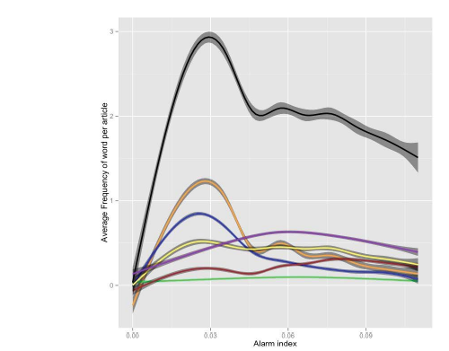
Articles about oil industry use more alarming language
3
2
Average frequency of word per article
1
0
0.00
0.03
0.06
0.08
Alarm index
Relationship between Alarm Index and five Alberta resource industry sectors: natural gas, forestry, mining, electricity, oil, pipelines, and rail.

Slide 36
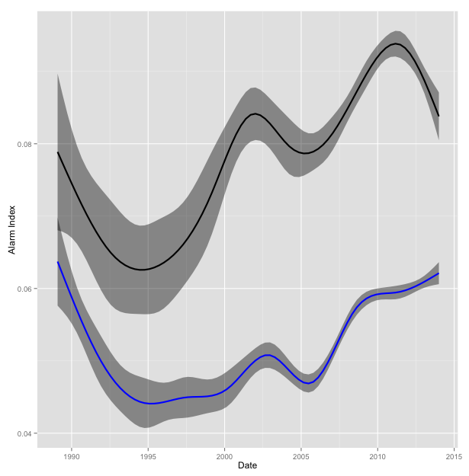
‘Tar sands’ label is more alarming than ‘oil sands’
0.08
0.06
Alarm index
0.04
1990
1995
2000
2005
2010
2015
Date
Articles that mention tar sands consistently use more
alarming language than articles containing oil sands
Notes:
In April 2008, as oil prices were increasing to the peak price of $147/barrel, 1600 ducks landed on Syncrude’s tailings ponds and died. The duck deaths were videotaped, posted online, and went viral. Higher media attention overall, during this highly visual and emotional event resulted in a frenzy of criticism.
As shown in this firgure, the alarmingness of tar sands began to rise immediately after this event.

Slide 37
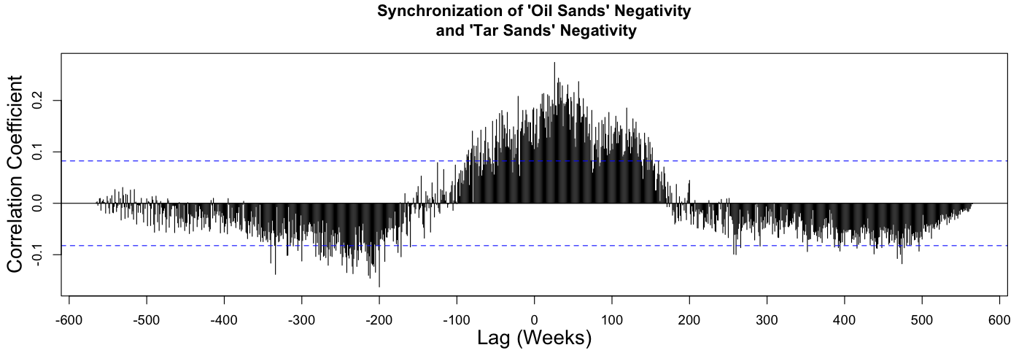
Past negativity of ‘tar sands’ spills over to create future negativity of ‘oil sands’
0.2
0.1
Correlation coefficient
0.0
-0.1
-600
-500
-400
-300
-200
-100
0
100
200
300
400
500
600
Lag (weeks)
Increases in tar sands negativity maximally predict increases in oil sands negativity 35 weeks in advance (approximately 8 months; top maximum value).
Notes:
To determine how these labels are inter-related, we undertook a time series analysis to determine whether two signals are predictive of each other, and at what delays. This figure shows that increases in tar sands negativity maximally predict increases in oil sands negativity 35 weeks in advance (approximately 8 months; top maximum value). Increases in oil sands negativity maximally predict decreases in tar sands negativity 200 weeks in advance (approximately 4 years; bottom minimum value).

Slide 38
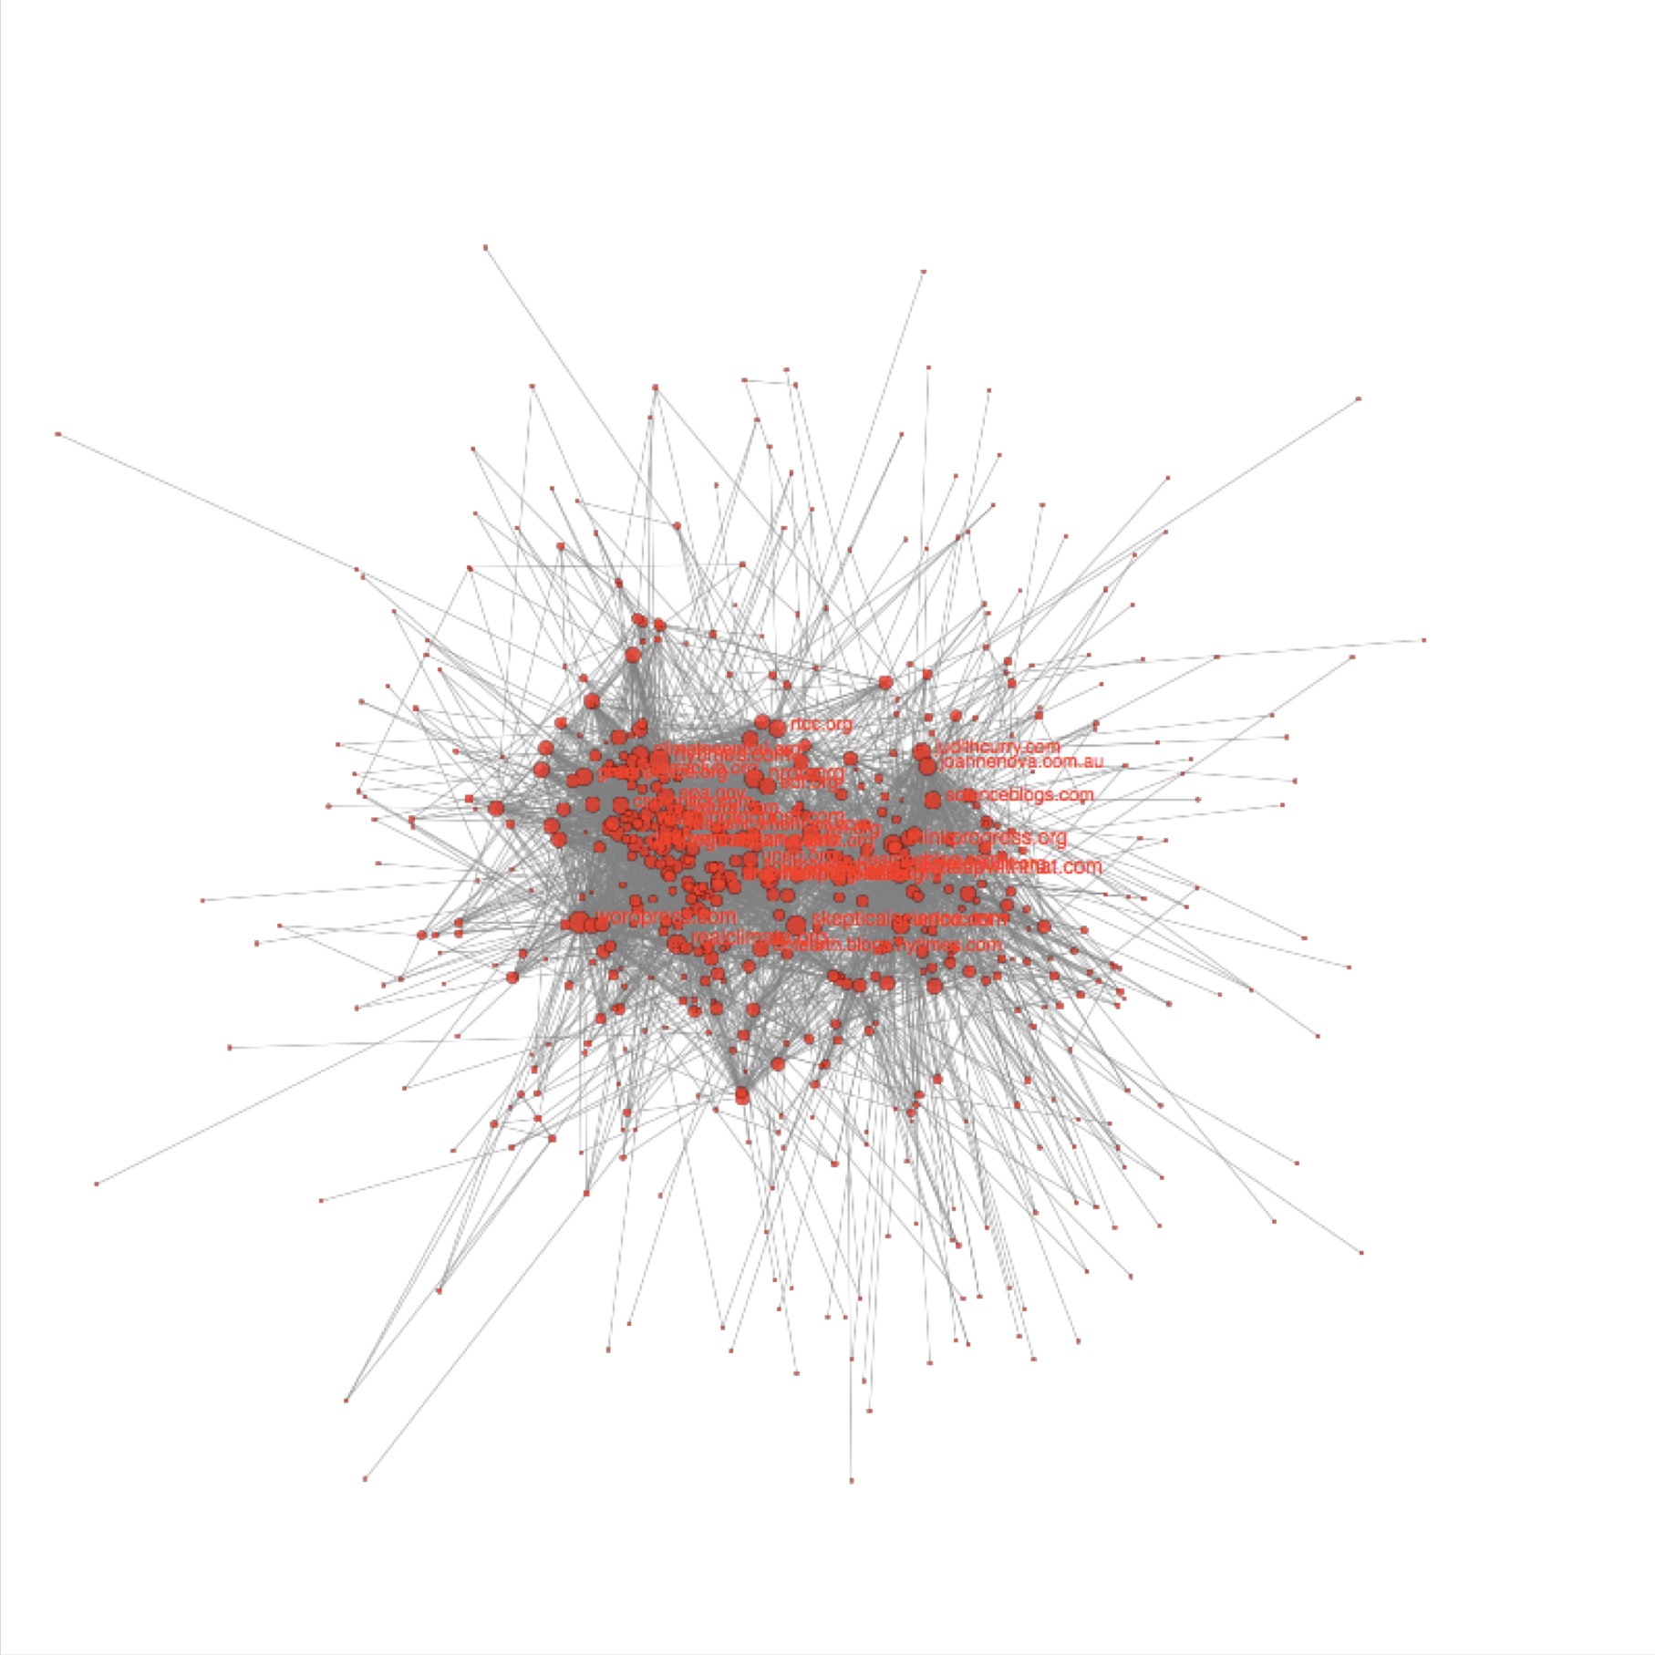
BESIDES AMPLIFYING/ATTENUATING, EMOTION CONNECTS
Lefsrud, L.M. Oberg, A. & Meyer, R. (2019). Organizational emotions in online climate change debate. Academy of Management Proceedings
Stretched center- periphery structure
583 organizations and blogs 4228 bidirectional ties
size of nodes: Degree

Slide 39

Emotional homophily/resonance is a better predictor of bidirectional links than any other variable
Number of bidirectional relations
300
250
200
150
The higher the emotional distance, the lower the likelihood of an existence of a relationship
orange: valence blue: arousal
100
50
Emotional distance (standardized)
0
0
10
20
30
40
50 60
Average for 2 observations
70
Valence
Arousal
Average 2 observations
Lefsrud, L.M. Oberg, A. & Meyer, R. (2019). Organizational emotions in online climate change debate. Academy of Management Proceedings

Slide 40
RISK COMMUNICATION IN A POST-TRUTH, POST-TRUST, POST-REALITY ERA
RISK COMMUNICATION NEEDS TO ADDRESS:
  Differences between hazard and risk
  Differences between a random event and underlying systemic variables (understanding sources of uncertainty)
  The scientific method of how risks are assessed
  The process of risk management decision-making
  The trade-offs and value conflicts when making risk management or regulatory decisions (including benefits)
  The meaning of standards and the respective goals behind them
Trust and credibility cannot be ‘produced’ or ‘manufactured’, but only earned in terms of performance and effective risk communication
Renn., O. (2019). Risk Governance Framework. https://irgc.epfl.ch/risk-governance/page-139715-en-html/
Notes:
Great slide

Slide 41
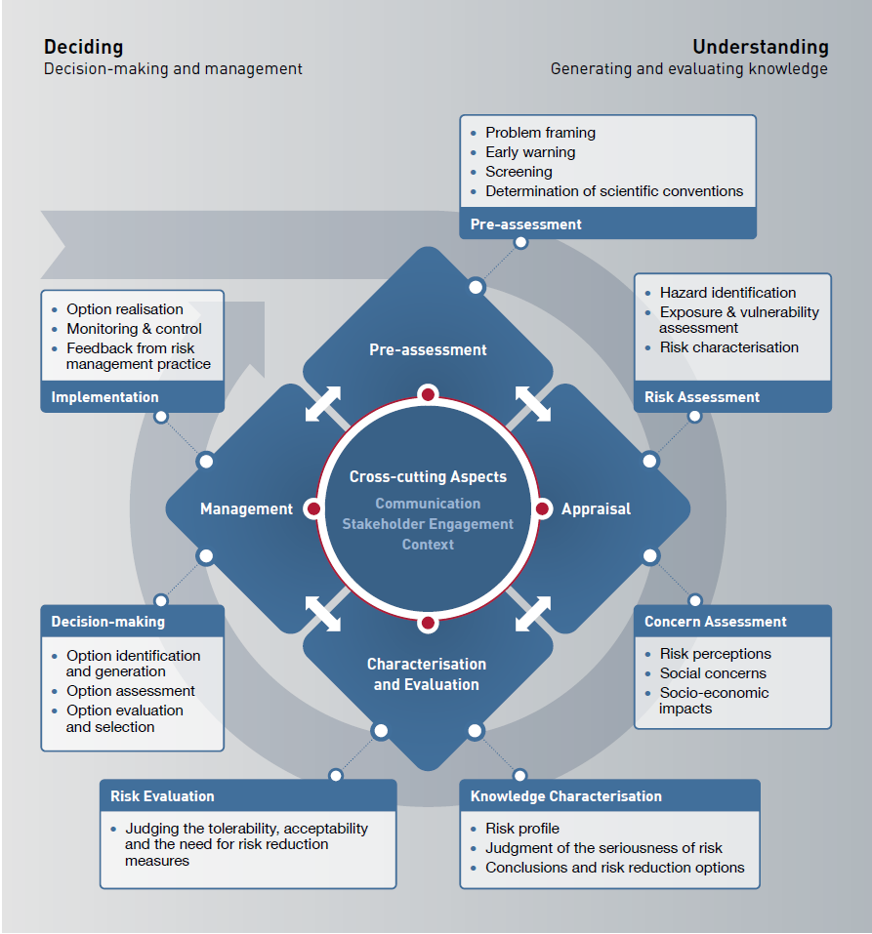
Renn., O. (2019). Risk Governance Framework. https://irgc.epfl.ch/risk-governance/page-139715-en-html/

Slide 42
THANK YOU! QUESTIONS?
Lianne M. Lefsrud, PhD, PEng,
Assistant Professor, Engineering Safety and Risk Management
E: lefsrud@ualberta.ca, W: liannelefsrud.com, T: @lefsrud
Funding/Support from:
Alberta Justice
Alberta Workers’ Compensation Board, Occupational Health & Safety
Construction Owners Association of Alberta
IBM, Mitacs, COSIA
Genome Canada
Natural Science and Engineering Research Council of Canada
Social Science and Humanities Research Council of Canada
Transport Canada
University of Alberta, VP Research & Faculty of Engineering

